Slide 2


Sathish Nadarajan
Senior Manager, AstraZeneca

Slide 3
Microsoft Azure Well-Architected Framework

Slide 4
Things to be Considered for an Application
Environments
Authentication
Authorization / User Roles
Hosting Environment
DB Location/Backup/Backup Frequency
Testing
SIT/UAT
Security/Vulnerability/Penetration Testing
Performance Testing
High Availability
Disaster Recovery / BCP Plan
Audit Log
Application Log
Budget
PIA/GDPR/PII
RID
Criticality
Externalization
Alignment to EA Principles
Integrations
Support and Governance Model
Data Model / Data Integrity between different Applications

Slide 5
Framework
Traditional on-premises | Modern cloud
Monolithic Designed for predictable scalability Relational database Synchronized processing Design to avoid failures (MTBF) Occasional large updates Manual management Snowflake servers | Decomposed Designed for elastic scale Polyglot persistence (mix of storage technologies) Asynchronous processing Design for failure (MTTR) Frequent small updates Automated self-management Immutable infrastructure

Slide 6
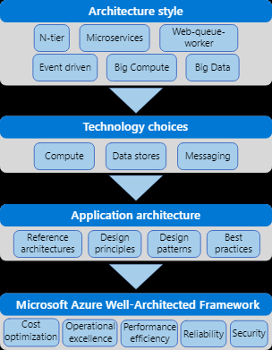
Framework

Slide 7
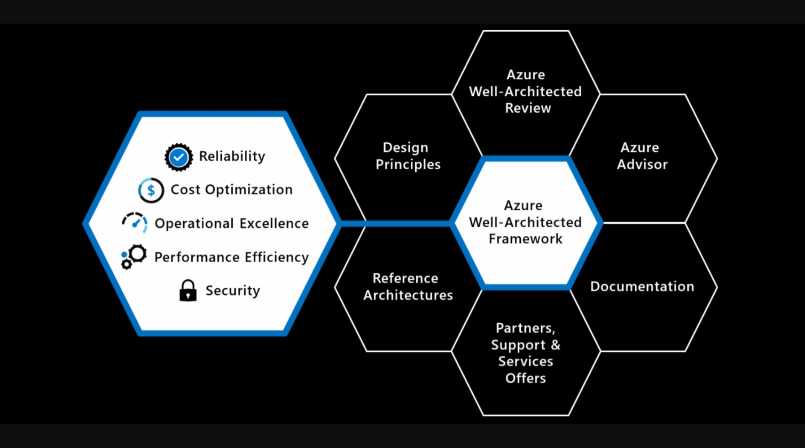
Framework

Slide 8
Reliability

Slide 9
Reliability Principles
Design for business requirements
Design for failure
Observe application health
Drive automation
Design for self-healing
Design for scale-out

Slide 10
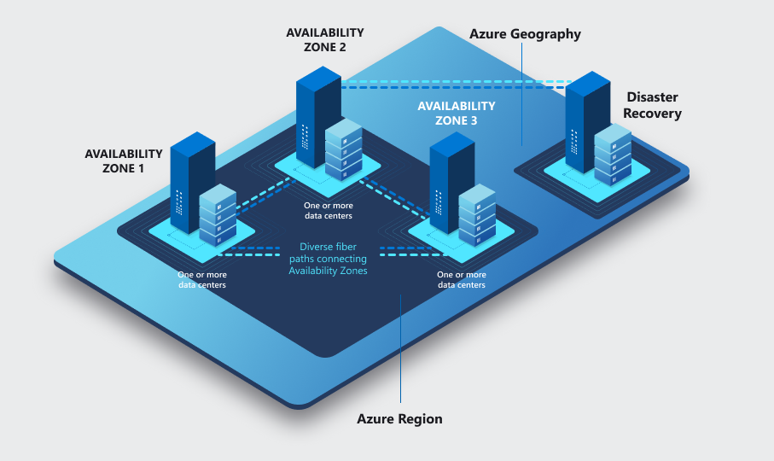
Region and Zones

Slide 11
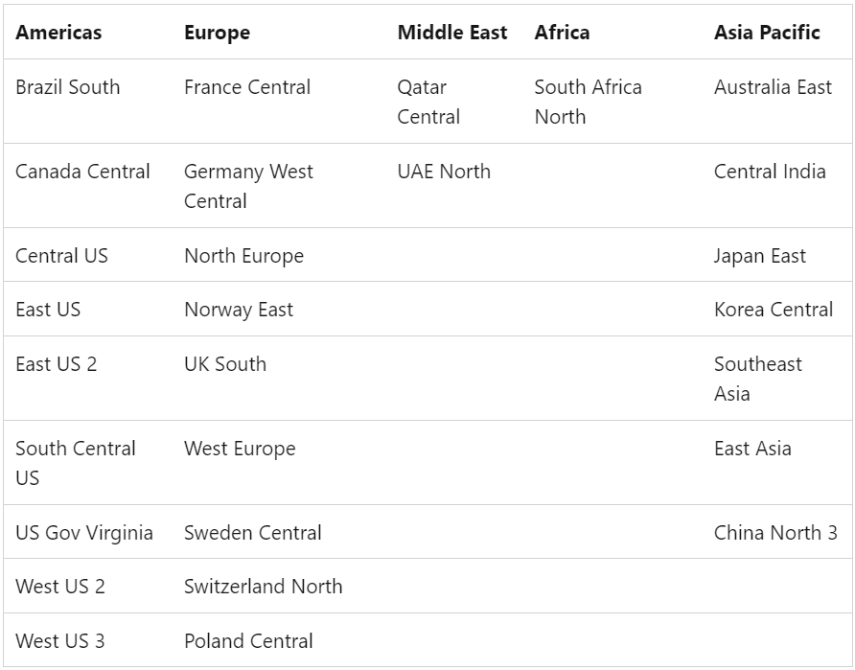

Slide 13
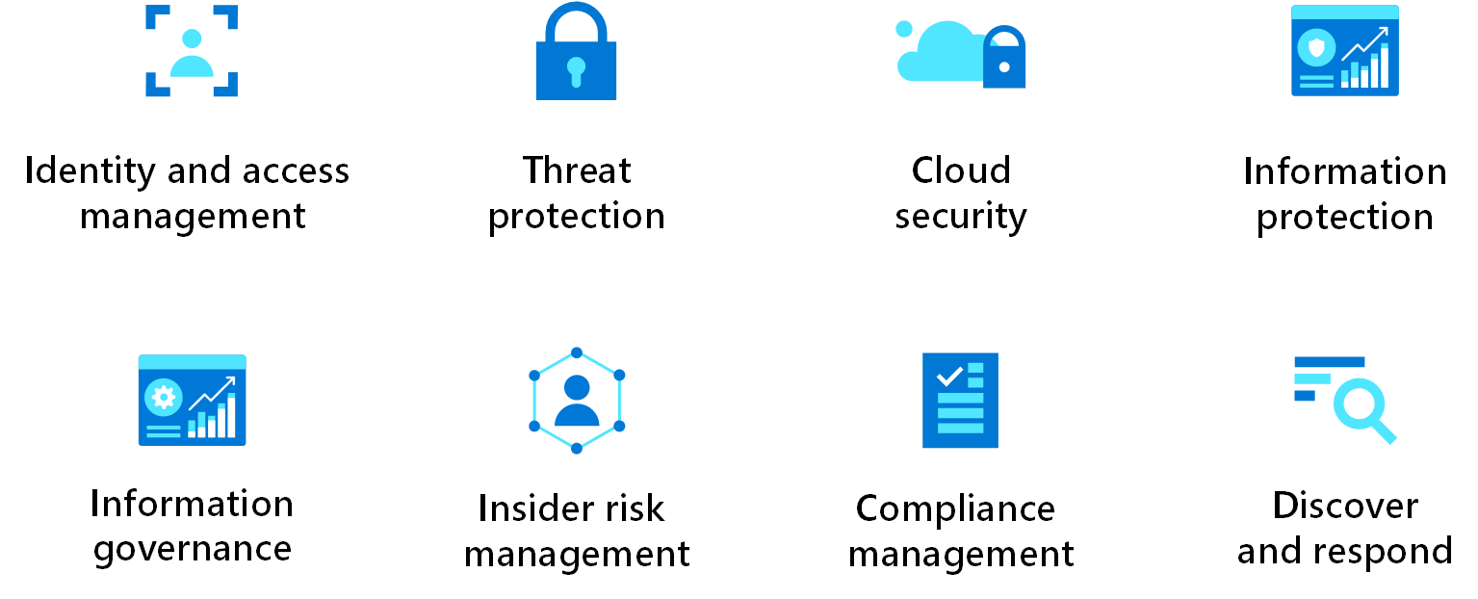
Security
Security is one of the most important aspects of any architecture. It provides the following assurances against deliberate attacks and abuse of your valuable data and systems:
Confidentiality
Integrity
Availability

Slide 14
Security Principles
Plan resources and how to harden them
Automate and use least privilege
Classify and encrypt data
Monitor system security, plan incident response
Identify and protect endpoints
Protect against code-level vulnerabilities
Model and test against potential threats
Do periodic User Assessment

Slide 15
Cost Optimization
Use the pay-as-you-go strategy for your architecture, and invest in scaling out, rather than delivering a large investment-first version.
Consider opportunity costs in your architecture, and the balance between first mover advantage versus fast follow.
Use the cost calculators to estimate the initial cost and operation costs.
Finally, establish policies, budgets, and controls that set cost limits for your solution.

Slide 16
Cost Optimization Principles
Choose the correct resources
Set up budgets and maintain cost constraints
Dynamically allocate and deallocate resources
Optimize workloads, aim for scalable costs
Continuously monitor and optimize cost management

Slide 17
Operational Excellence
The operational excellence pillar covers the processes that keep an application running in production.
Deployments must be reliable and predictable.
Automated deployments reduce the chance of human error.
Fast and routine deployment processes don't slow down the release of new features or bug fixes.
It's equally important to be able to quickly roll backward or forward if an update has problems.

Slide 18
Operational Excellence Principles
Optimize build and release processes
Understand operational health
Rehearse recovery and practice failure
Embrace continuous operational improvement
Use loosely coupled architecture
Use modern architecture patterns such as:
microservices
loosely coupled
serverless
and pair this with cloud design patterns such as:
Circuit breakers
Load-Leveling
Throttling
and advanced deployment strategies like:
Canary
Blue-green
Staggered

Slide 19
Performance Efficiency
Performance efficiency is the ability of your workload to scale to meet the demands placed on it by users in an efficient manner.
Before the cloud became popular, when it came to planning how a system would handle increases in load, many organizations intentionally provisioned oversized workloads to meet business requirements.
This decision made sense in on-premises environments because it ensured capacity during peak usage.
Capacity reflects resource availability (CPU and memory).
Capacity was a major consideration for processes that would be in place for many years.

Slide 20
Performance Efficiency Principles
Design for horizontal scaling
Shift-left on performance testing
Continuously monitor for performance in production

Slide 21
Ten Design Principles
Design for self healing. In a distributed system, failures happen. Design your application to be self healing when failures occur.
Make all things redundant. Build redundancy into your application, to avoid having single points of failure.
Minimize coordination. Minimize coordination between application services to achieve scalability.
Design to scale out. Design your application so that it can scale horizontally, adding or removing new instances as demand requires.
Partition around limits. Use partitioning to work around database, network, and compute limits.
Design for operations. Design your application so that the operations team has the tools they need.
Use managed services. When possible, use platform as a service (PaaS) rather than infrastructure as a service (IaaS).
Use an identity service. Use an identity as a service (IDaaS) platform instead of building or operating your own.
Use the best data store for the job. Pick the storage technology that is the best fit for your data and how it will be used.
Design for evolution. All successful applications change over time. An evolutionary design is key for continuous innovation.
Build for the needs of business. Every design decision must be justified by a business requirement.

Slide 22
Q & A

Slide 23
Feedback

Slide 24
THANK YOU!
Sathish Nadarajan
Senior Manager, AstraZeneca

